Slide 1


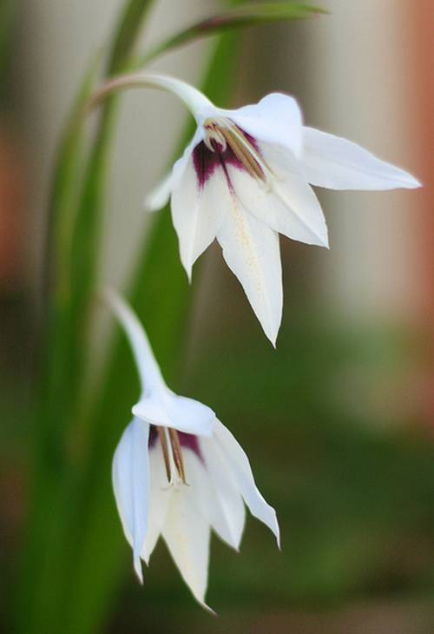

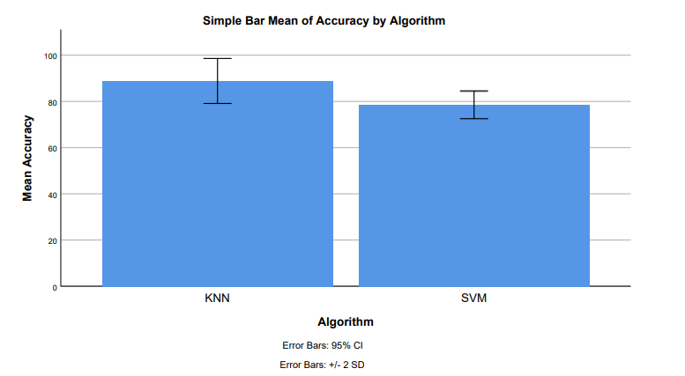
Name: V. Anil Kumar Yadav Register Number: 192110198
Guided by Dr M Rajasekar
Ms. Poorani.S
Guided by Dr. Mary Valantina. G
A Study on Sword lily Petal Features using K Nearest Neighbor with K dimensional Tree and Support Vector Machine Algorithms to Improve the Accuracy of Classification.
INTRODUCTION
The study aims to accurately classify sword lily species and understand their various patterns.
Scientifically known as Gladiolus, sword lilies are attractive seasonal flowers used in ornamental landscaping, with diverse applications in industries like cosmetics and medicine.
Classification of sword lily species is crucial for scientific understanding, biodiversity conservation, and practical applications in medicine and economics.
Sword lilies have various uses in medicine, economic value in cultivation and trading, and cultural significance in ceremonies and rituals.
The study employs machine learning techniques, specifically K Nearest Neighbor and Support Vector Machine, to classify sword lily species based on flower attributes.
The research involves examining petal and sepal size of sword lily flowers to identify patterns and predict species.
A machine learning model is trained with available data to predict sword lily species when presented with unseen data, aiming to improve accuracy over time.
Over the past five years, research in sword lily classification using machine learning has seen a multidisciplinary approach, gradually improving accuracy rates with K Nearest Neighbor and Support Vector Machine algorithms. The study seeks to determine the algorithm with the highest accuracy rate.
MATERIALS AND METHODS
Feature Extraction
Model Selection
Model Training
Model Evaluation
Model Deployment
Data collection
Analyze the importance of features and select relevant ones for classification.
Optionally, perform feature engineering to create new informative features.
Choose K Nearest Neighbor (KNN), K-dimensional Tree, and Support Vector Machine (SVM) algorithms for classification.
Train the models using the preprocessed dataset and the optimized hyperparameters
Evaluate the performance of each model using appropriate evaluation metrics such as accuracy, precision, recall, F1-score, and confusion matrix.
Compare the performance of KNN, K-dimensional Tree, and SVM algorithms.
Gather a dataset containing samples of sword lily petals along with their features
Data Preprocessing
Model Testing
Preprocess the data by handling missing values, scaling features, and encoding categorical variables if necessary.
Ensure you have a separate testing dataset containing sword lily petal features that were not used during model training
Result
Conclude the study by summarizing the findings and identifying the best-performing algorithm for the task
RESULTS
K Nearest Neighbor v/s Support Vector Machine
K Nearest Neighbor Algorithm has highest accuracy 91.85% when compared with the Accuracy of Support Vector Machine 84.55%.
The standard deviation of K Nearest Neighbor Algorithm and Support Vector Machine Algorithm are 3.017 and 4.870 respectively.
The standard error mean of K Nearest Neighbor Algorithm and Support Vector Machine Algorithm are 1.089 and 0.675 respectively.
These results that K Nearest Neighbor algorithm is best for these research of classification of Sword lily.
Group Statistics table 1
Independent sample table |  | Levene's test for equality of variances | T- test for equality of means
 |  |  |  |  |  |  |  |  | 95% confidence interval of the difference
 |  | F | Sig. | t | df | Sig. (2-tailed) | Mean difference | Std. Error difference | Lower | Upper
Accuracy | Equal variances assumed Equal variances not assumed | 3.269 | 0.079 | 8.041 | 38 | 0.032 | 10.300 | 1.281 | 7.707 | 12.893
 | Equal variances assumed Equal variances not assumed |  |  | 8.041 | 31.713 | 0.032 | 10.300 | 1.281 | 7.690 | 12.910
 | Algorithm | N | Mean | Std.Deviation | Std.Error Mean
Accuracy | K Nearest Neighbor | 20 | 88.85 | 3.017 | 1.089
 | Support Vector Machine | 20 | 78.55 | 4.870 | 0.675
Figure 1:The shown groups in the X-axis are the K Nearest Neighbor algorithm vs Support Vector Machine Algorithm and the Y-axis mean accuracy of detection ± 2 standard deviations.
finding the accuracy of the two algorithms, the mean accuracy of K Nearest Neighbor is 92.05% better than the Support Vector Machine 78.55% and St. Deviation is slightly lower than the Support Vector Machine.
DISCUSSION AND CONCLUSION
K Nearest Neighbor Algorithm outperforms Support Vector Machine Algorithm in the classification of sword lily species.
The accuracy percentage of K Nearest Neighbor Algorithm is 88.85%, whereas Support Vector Machine Algorithm achieves 78.55%.
A statistically significant difference in accuracy (p<0.05) is observed between the two algorithms.
Various studies explore supervised learning approaches for sword lily species prediction, with an emphasis on machine learning techniques.
An efficient approach is proposed for the classification of sword lily dataset using neuro-fuzzy techniques.
A study by Prof. Joylin Priya Pinto and Prof. Jyothi Shetty stands out for its accurate classification of sword lily species using neural networks.
SVMs have limitations including sensitivity to kernel function choice, computational complexity, binary classification nature, and struggle with noisy or overlapping data.
The limitations of SVMs emphasize the need for careful preprocessing and consideration in real-world applications.
K Nearest Neighbor does not require a training phase, relying on observable data similarities, and is considered sophisticated.
The superiority of K Nearest Neighbor over Support Vector Machine in sword lily species classification underscores the importance of selecting appropriate algorithms and preprocessing techniques in machine learning applications.
BIBLIOGRAPHY
Sabry, Fouad. 2023. K Nearest Neighbor Algorithm: Fundamentals and Applications. One Billion Knowledgeable.
Shilpa Sethi, Mamta Kathuria, "Ensemble Feature Reduction Technique for Flower Species Identification", 2023 International Conference on Advanced Computing & Communication Technologies .
Sabry, Fouad. 2023. K Nearest Neighbor Algorithm: Fundamentals and Applications. One Billion Knowledgeable.
Abu-Bader, Soleman H., and Professor and Chair of Research Sequence at the School of Social Work Soleman H Abu-Bader. 2021. Using Statistical Methods in Social Science Research: With a Complete SPSS Guide. Oxford University Press, USA.
Mohri, Hideo. 2019. Imperial Biologists: The Imperial Family of Japan and Their Contributions to Biological Research. Springer.
Preisach, Christine, Hans Burkhardt, Lars Schmidt-Thieme, and Reinhold Decker. 2008. Data Analysis, Machine Learning and Applications: Proceedings of the 31st Annual Conference of the Gesellschaft Für Klassifikation
Galvin, Kathleen A., Robin S. Reid, Roy H. Behnke Jr, and N. Thompson Hobbs. 2007. Fragmentation in Semi-Arid and Arid Landscapes: Consequences for Human and Natural Systems. Springer Science & Business Media.

